Slide 1


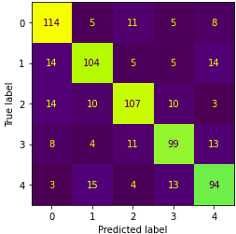
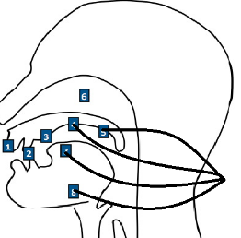
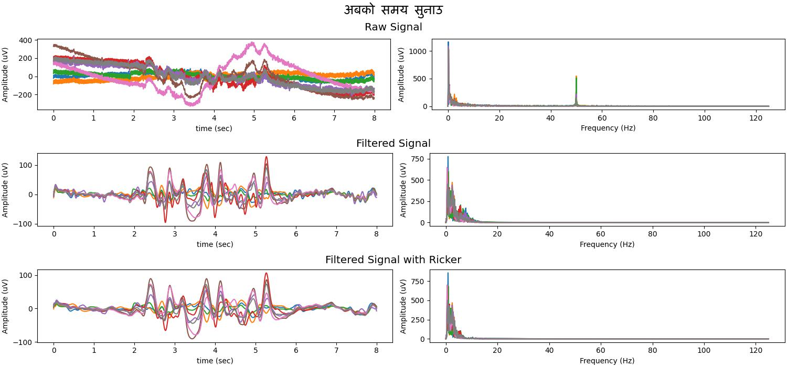

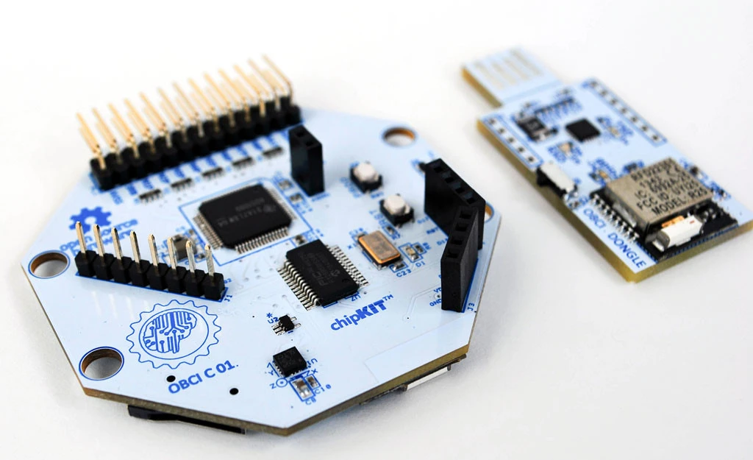


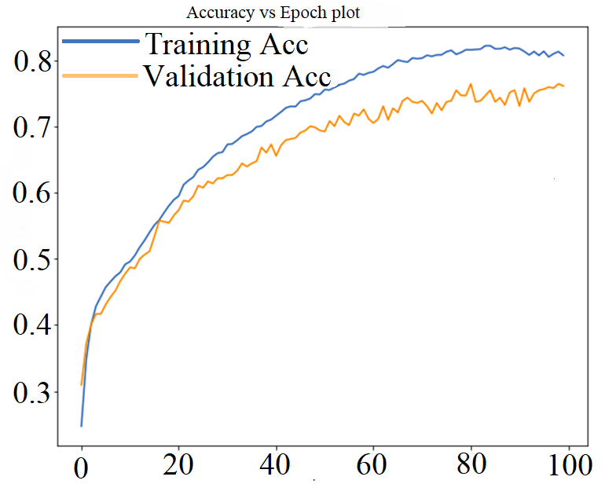
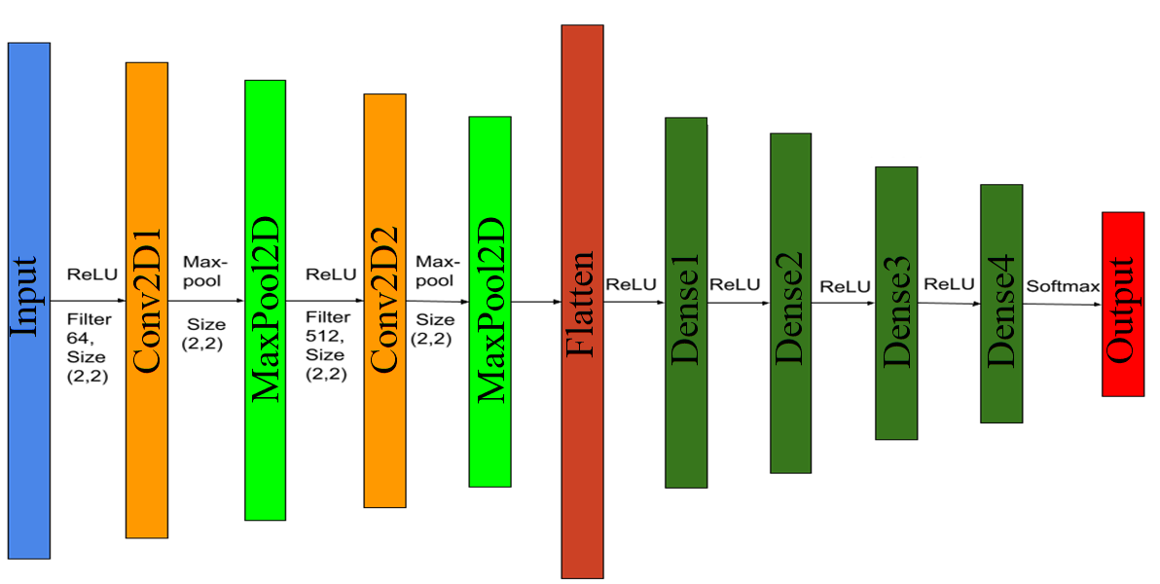
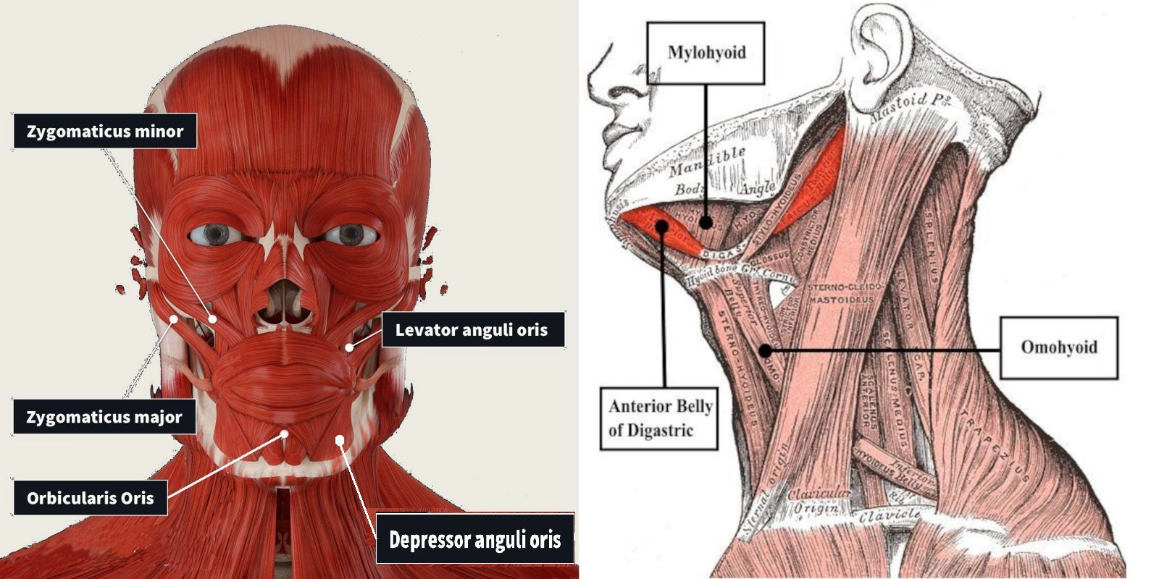
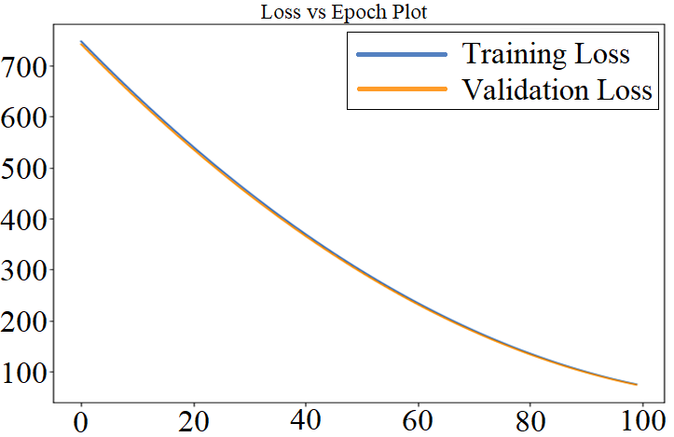
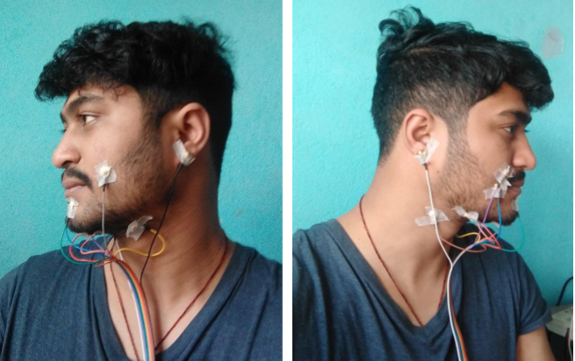
Silent Speech Recognition in Nepali
Rabin Nepal, Rhimesh Lwagun, Sanjay Rijal, Upendra Subedi, Dinesh Baniya Kshatri
Department of Electronics and Computer Engineering
Thapathali Campus, Institute of Engineering, Tribhuvan University, Nepal
INTRODUCTION
SYSTEM BLOCK DIAGRAM
FINDINGS AND ANALYSIS
Speech is a convenient way to interact with smart electronic gadgets. However, normal audible speech is predisposed to noisy external environments and subjected to privacy issues. This research work breaks down the human speech process and exploits the bio-signals generated during internal articulation, which is a part of the speech generation process. Sentences uttered silently by a user are imperceptibly sent to a remote device for seamless human computer interaction.
Signals from articulatory muscles
Cyton Board
ADS1299 PIC32MX250F128B
Amplifier
ADC
Memory
Serial Buffer
Parallel Input
Computer
Label | Sentences
0 | बत्तिको अवस्था बदल
1 | आजको मौसम बताउ
2 | 'एउटा सङ्गीत बजाउ
3 | 'पङ्खाको स्थिती बदल
4 | अबको समय सुनाउ
Predicted Text
Machine Learning Model
Feature Extraction
Data Preprocessing
Raw signal included DC offsets, line noise and ECG artifacts
Normalization and notch filtration removed the DC offsets and line noise
ECG artifacts were removed via Ricker wavelet
INSTRUMENTATION
OBJECTIVE
OpenBCI
Cyton Board
Goldcup
EMG Electrodes
To process and analyze bio-signals from speech articulator muscles for recognizing silently uttered Nepali sentences
Electrolyte
Ten20 Paste
SPEECH ARTICULATOR MUSCLES
METHODOLOGY
EMG Channel | Muscle Name
1. | Levator Angulis Oris
2. | Zygomaticus Minor
3. | Zygomaticus Major
4. | Orbicularis Oris
5. | Omohyoid
6. | Anterior Belly of Digastric
7. | Mylohyoid
8. | Depressor Anguli Oris
Selected muscles around the face and the neck region formed recording sites for bio-signals
The sites were gel coated to reduce impedance between skin and electrode
Signals recorded from articulator network were normalized and filtered to remove line noise and ECG artifacts
Short-time Fourier transform provided the optimum features required to train a convolutional neural network
The CNN model consisted of 2 convolution, 2 max pooling layers and 4 dense layers
Accuracy of about 80% in the training dataset and 74.75% in the testing dataset was achieved
RECOMMENDATIONS
CONCLUSION
Explore other machine learning models that perform better with time series inputs
Consider the accuracy and consistency in electrode placement during dataset creation
Take into account muscle fatigue during long sessions of silent speech recordings
Silent speech recognition by decoding neuromuscular signals is feasible with a permissible error rate
System performance greatly depends upon electrode arrangement, utterance rate and the quality of the training dataset

